Slide 1

Unit – 1 Comprehensive Listening skills 1.1 WHAT AND WHY 1.2 Techniques for improving listening skills
3rd semester

Slide 2
Unit 1 Comprehensive Listening Skills
1.1 What and Why
Understanding Comprehensive Listening Skills:
Comprehensive listening skills involve the ability to accurately receive and interpret messages in the communication process. These skills are more than just hearing; they require active engagement and cognitive processing to understand the speaker’s message. Comprehensive listening is crucial for effective communication in both personal and professional contexts, as it helps in understanding others better, building relationships, making informed decisions, and avoiding misunderstandings

Slide 3
What is Comprehensive Listening?
Comprehensive listening is a critical skill that goes beyond merely hearing words.
It involves a deep engagement with the speaker’s message, including understanding the context, emotions, and nuances behind the communication.
This type of listening is essential in all areas of life, from personal relationships to professional interactions, as it fosters better understanding, enhances communication, and improves the quality of interactions.
Comprehensive listening requires active participation and critical thinking.
It is not a passive activity but rather an active process where the listener is fully engaged in decoding, interpreting, and responding to the message.
This engagement helps in accurately capturing the speaker’s intent and feelings, thereby reducing misunderstandings and fostering clearer, more effective communication.

Slide 4
VII. The process of comprehensive listening can be broken down into several key components: hearing, understanding, remembering, interpreting, evaluating, and responding.
VIII. Each of these components plays a crucial role in ensuring that the listener can fully grasp and respond appropriately to the speaker’s message.
IX. By developing these skills, individuals can become more effective communicators, capable of navigating complex conversations and building stronger, more empathetic relationships.
X. In today’s fast-paced world, where distractions are abundant and communication is often rushed, the ability to listen comprehensively is more valuable than ever.
XI . It enables individuals to connect more deeply with others, resolve conflicts more effectively, and make more informed decisions. As such, honing comprehensive listening skills is an investment in both personal and professional growth.

Slide 5
1.2 Significance of Comprehensive Listening Skills
Comprehensive listening skills are vital for effective communication and interaction in various aspects of life. They go beyond merely hearing words to include understanding context, emotions, and underlying meanings, which makes them indispensable in numerous scenarios. Here are key points highlighting their significance:
1. Enhanced Communication Comprehensive listening ensures that information is exchanged accurately and efficiently. By fully understanding the speaker’s message, listeners can reduce misunderstandings and foster clearer, more productive conversations. This clarity in communication is essential in both personal and professional settings, as it allows for the smooth transfer of ideas and information.
2. Improved Relationships Attentive listening demonstrates respect and empathy towards the speaker, which is fundamental in building trust and strengthening connections between individuals. In personal relationships, it shows care and concern, while in professional settings, it fosters collaboration and teamwork. By valuing others’ perspectives, listeners can create a more supportive and understanding environment, leading to deeper and more meaningful connections.

Slide 6
3.Conflict Resolution Comprehensive listening is crucial in understanding all sides of a conflict, which helps in finding amicable solutions. By fully grasping the concerns and viewpoints of all parties involved, listeners can address the root causes of disagreements. This leads to more effective and lasting resolutions, as the solutions are based on a thorough understanding of the issues at hand, rather than superficial compromises.
4 Effective Problem-Solving A thorough understanding of a problem from multiple perspectives aids in finding the best solution. Comprehensive listening allows individuals to gather all relevant information and consider different viewpoints, which facilitates better decision-making processes. By ensuring that all aspects of a problem are understood, listeners can develop more effective and innovative solutions, leading to improved outcomes in various situations.
5. Increased Empathy and Understanding Comprehensive listening involve paying attention to the emotional content and nonverbal cues of the speaker, which increases empathy and understanding. This emotional intelligence is crucial in building strong interpersonal relationships and fostering a compassionate and supportive environment.

Slide 7
6. Professional Success In professional settings, comprehensive listening skills are essential for leadership, teamwork, and customer relations. Leaders who listen effectively can inspire and motivate their teams, understand their needs and concerns, and make informed decisions. Similarly, professionals who listen well .
7. Personal Growth Developing comprehensive listening skills contributes to personal growth by enhancing self-awareness and mindfulness. It encourages individuals to be present in the moment, understand their own communication styles, and improve their interactions with others. This leads to a more fulfilling and balanced life.
Comprehensive listening skills are fundamental for effective communication, relationship building, conflict resolution, problem-solving, empathy, professional success, and personal growth. By cultivating these skills, individuals can enhance their interactions, achieve their goals, and contribute positively to their personal and professional environments

Slide 8
1.3 Features of Comprehensive Listening
1 Active Listening
Active listening involves fully engaging with the speaker, paying close attention to their words, tone, and body language. This means avoiding distractions, maintaining eye contact, and showing interest through nodding or verbal affirmations. Active listeners focus on understanding the speaker’s message rather than preparing a response while the other person is talking.
Concentration: Focusing entirely on the speaker without getting distracted.
Interaction: Providing verbal affirmations like “I see” or “Go on” to encourage the speaker.
Summarizing: Briefly summarizing points to ensure understanding.
.

Slide 9
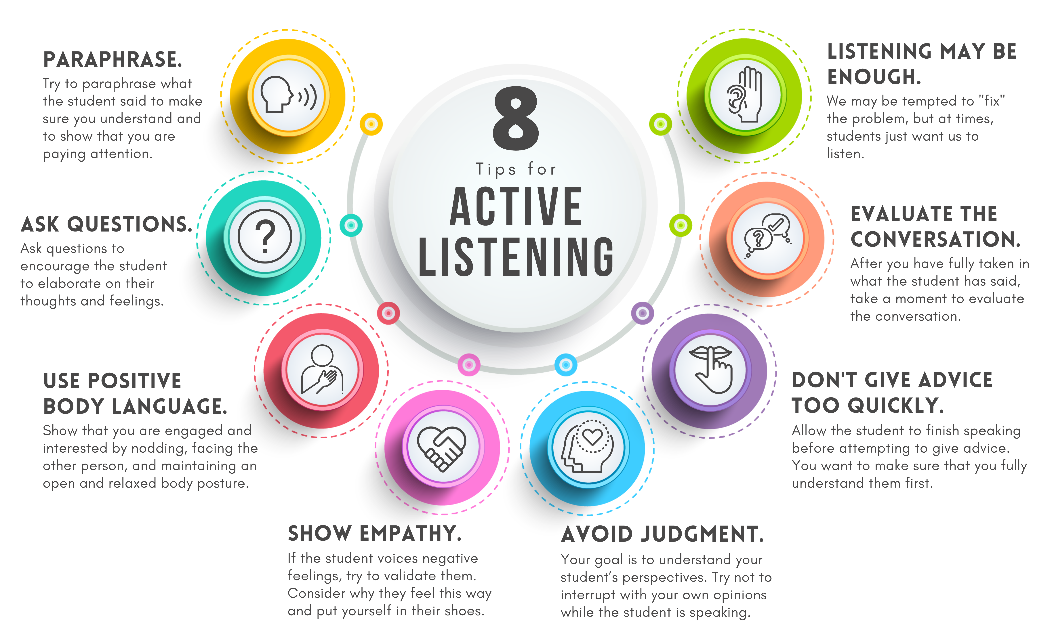
Features of comprehensive listening

Slide 10
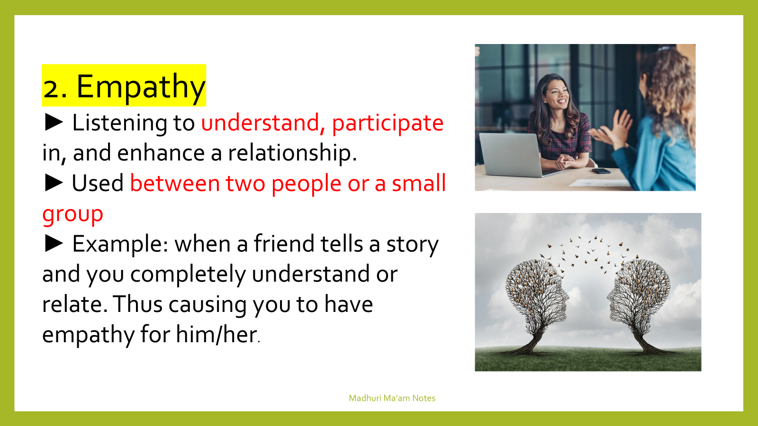

Slide 11

3. Patience
Patience is crucial for comprehensive listening as it allows the listener to give the speaker ample time to express their thoughts without interruption. This includes being comfortable with pauses and silences, which can provide the speaker with the space needed to articulate their message fully.
Allowing Silence: Giving the speaker time to think and continue without interruption.
Non-Interruptive Behavior: Avoiding interrupting or finishing the speaker’s sentences.

Slide 12
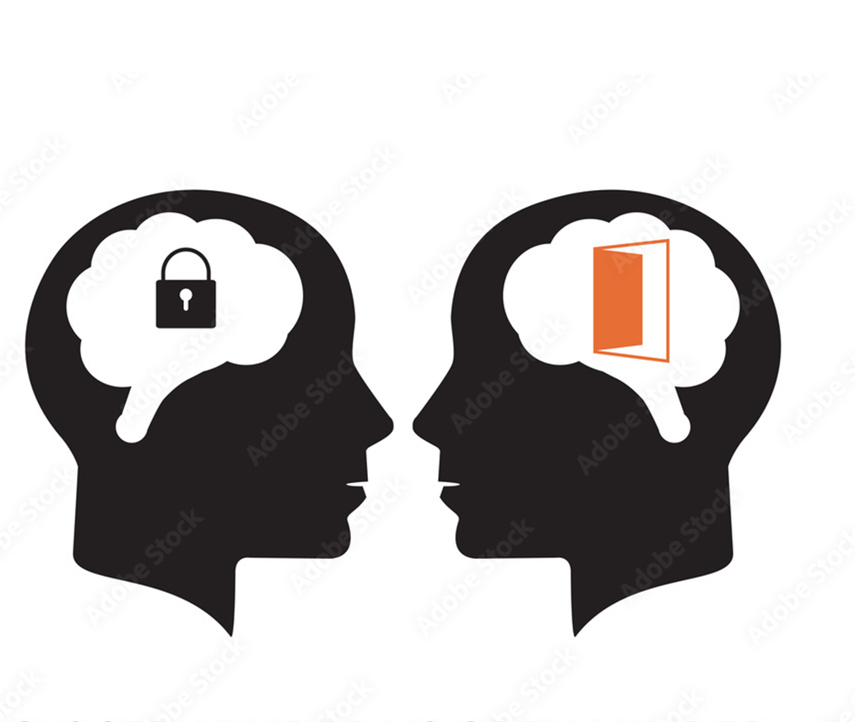
4 .Open-Mindedness
Open-mindedness involves being receptive to new ideas and different viewpoints. It means listening without judgment or preconceived notions, allowing the speaker to share their perspective freely. Openminded listeners are willing to consider and respect ideas that differ from their own.
Non-Judgmental Attitude: Listening without forming immediate opinions.
Acceptance: Acknowledging different viewpoints, even if they differ from your own.
Willingness to Learn: Being open to changing your views based on new information.

Slide 13
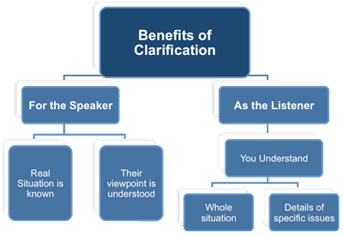
5 .Clarification
Clarification is the process of asking questions to ensure the listener has accurately understood the speaker’s message. This can involve requesting more information or asking the speaker to elaborate on certain points. Clarifying questions demonstrate that the listener is engaged and striving for accurate comprehension.
Clarifying Questions: Asking for more information or examples, e.g., “Can you explain what you mean by...?” Restating: Repeating back what you’ve heard to confirm understanding, e.g., “So, you’re saying that...”

Slide 14
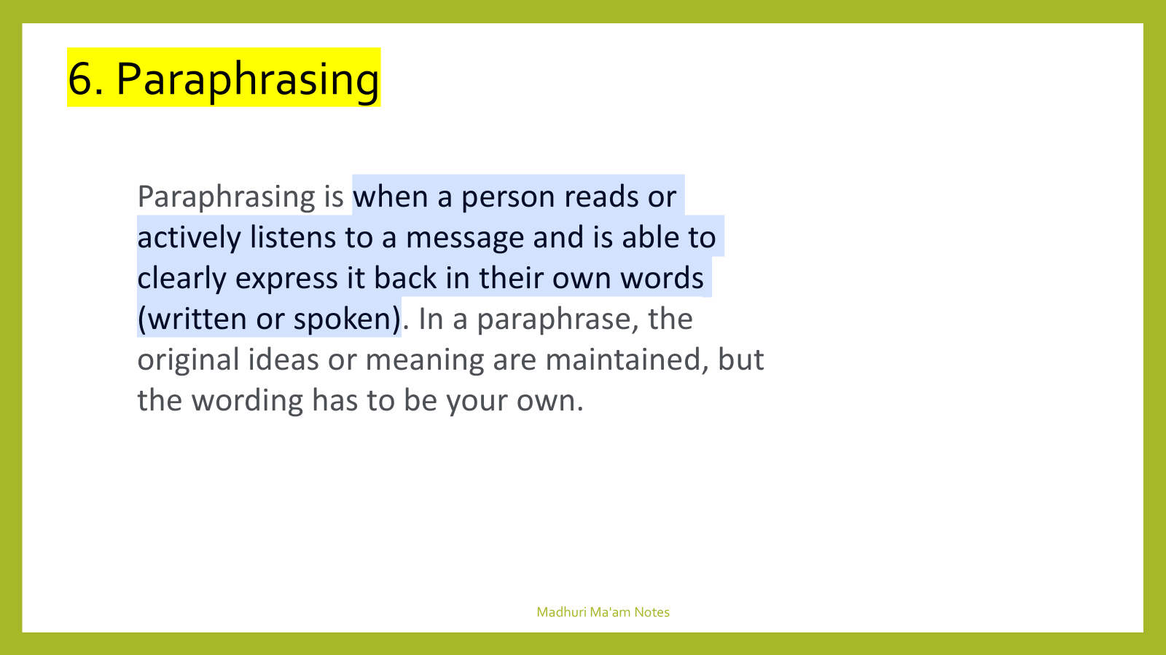

Slide 15
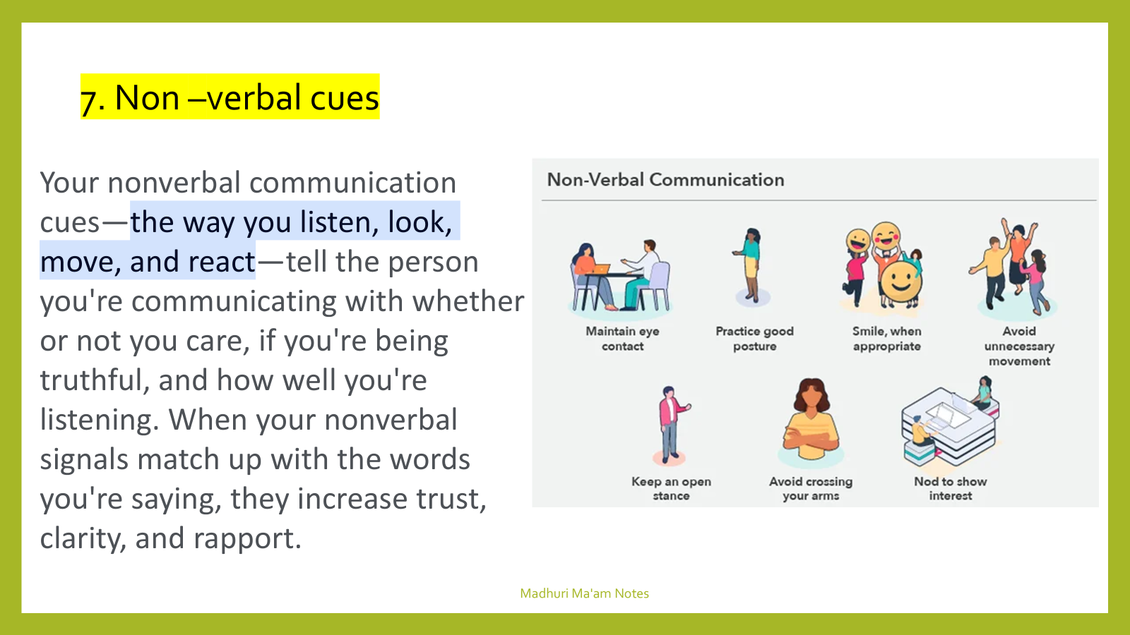

Slide 16

8 Memory
Memory is essential for retaining and recalling information communicated during a conversation. Good listeners remember key details and can refer back to them in future discussions. This helps to build continuity in conversations and shows the speaker that their message has been valued and retained.
Short-Term Memory: Keeping track of the immediate points being discussed.
Long-Term Memory: Remembering past conversations and context to better understand current discussions.
Note-Taking: Jotting down key points to aid memory.

Slide 17
9 Feedback
Providing feedback involves giving a response that reflects the listener’s understanding and interpretation of the speaker’s message. This can be verbal, such as summarizing what has been said, or nonverbal, such as nodding in agreement. Effective feedback ensures the speaker feels heard and understood, and it helps to reinforce communication.
Positive Reinforcement: Nodding, smiling, or using verbal affirmations.
Constructive Comments: Offering thoughtful responses that add value to the conversation.
Reflective Feedback: Sharing how the message affects you or what it makes you think about.

Slide 18
10 Analytical Thinking
Analytical thinking in listening involves critically evaluating the information being presented. This includes assessing the credibility of the speaker, analysing the logic of their arguments, and identifying any biases or assumptions. Analytical listeners can discern the deeper meaning and implications of the message, leading to a more informed and thoughtful response.
Analyzing Content: Assessing the validity and relevance of the message.
Connecting Ideas: Relating new information to what you already know.
Problem-Solving: Using the information to address issues or make decisions.

Slide 19
Unit 1.2 Techniques for improving listening skills
Active Listening involves fully engaging with the speaker, paying close attention to their words, tone, and body language. This means avoiding distractions, maintaining eye contact, and showing interest through nodding or verbal affirmations. Active listeners focus on understanding the speaker’s message rather than preparing a response while the other person is talking. Engaging fully with the speaker, processing the information, and providing feedback are essential aspects of active listening.
Avoiding Interruptions Allow the speaker to finish their thoughts without interruption. Resist the urge to jump in with your own comments or solutions. By letting the speaker express themselves fully, you demonstrate respect and ensure you understand their message completely before responding.

Slide 20
3.Asking Questions Clarify any points that are unclear by asking open-ended questions. This not only helps you understand the speaker’s message better but also shows that you are actively engaged and interested in what they are saying. Questions can also prompt the speaker to elaborate and provide more detailed information.
4.Paraphrasing and Summarizing Restate the speaker’s message in your own words to confirm understanding. Summarizing key points helps reinforce your comprehension and shows the speaker that you are listening attentively. This technique can also highlight any misunderstandings that need to be addressed.
5.Practicing Empathy Try to understand the speaker’s emotions and perspectives. Show empathy by acknowledging their feelings and validating their experiences. Empathetic listening fosters trust and strengthens relationships by demonstrating genuine care and concern.

Slide 21
6. Taking Notes Write down important points during conversations, especially in professional settings or during complex discussions. Notetaking helps you remember details and provides a reference for future conversations. It also shows the speaker that you value their message.
7.Improving Your Concentration Work on maintaining focus during conversations. Avoid multitasking and minimize external distractions. Techniques such as mindfulness and meditation can help improve your concentration and enhance your ability to stay present during discussions.
8.Being Patient Give the speaker ample time to articulate their thoughts without rushing them. Be comfortable with pauses and silences, as they can allow the speaker to gather their thoughts and express themselves more clearly. Patience in listening ensures that you receive the full message and respond appropriately.

Slide 22
Types of comprehensive listening skill
Active listening
Passive listening
Critical listening
Empathic listening
Appreciative listening
Reflective listening

Slide 23
Types of comprehensive skill
Active Listening: Fully concentrating, understanding, responding, and remembering what is being said. This includes:
Paying Attention: Giving the speaker your undivided attention and acknowledging their message.
Showing That You’re Listening: Using body language and gestures to convey your attention.
Providing Feedback: Reflecting on what has been said by paraphrasing and summarizing.
Deferring Judgment: Allowing the speaker to finish before forming an opinion.
Responding Appropriately: Engaging in a way that is respectful and understanding.

Slide 24
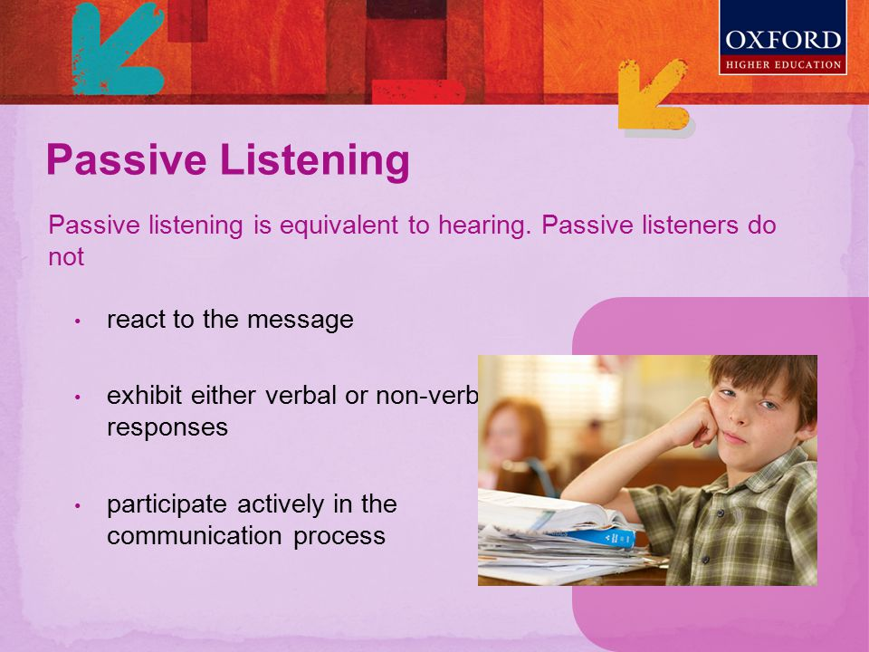
2. Passive Listening
2.

Slide 25

3. Critical Listening:
Evaluating and analyzing the message for accuracy and validity.
Critical listening is a form of listening that is usually not mentioned, since it involves analysis, critical thinking and judgment. Making judgments during listening is often considered as a barrier to understanding a person.

Slide 26
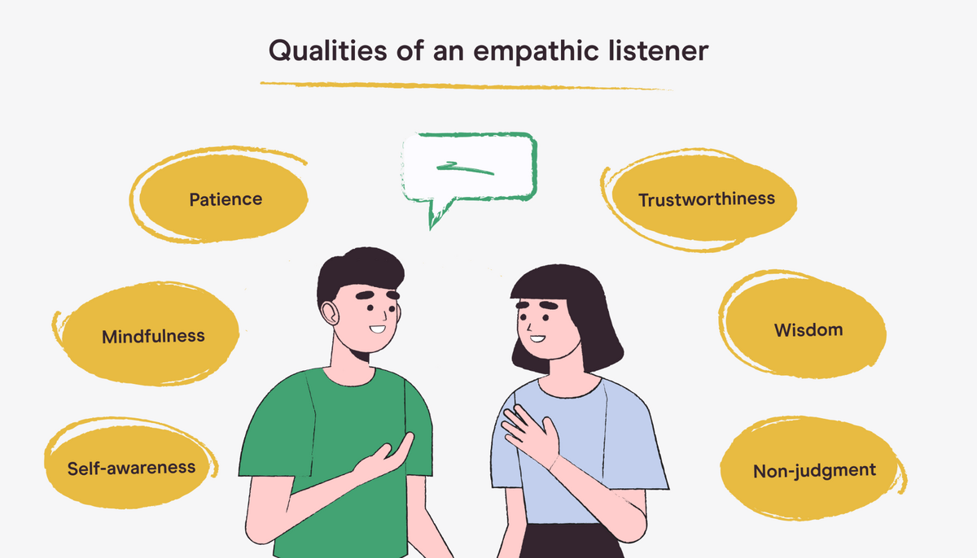
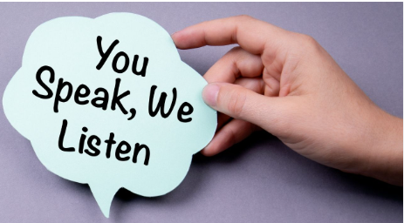
4.Empathetic Listening:
.
Understanding the speaker’s feelings, thoughts, and perspective

Slide 27
5.Appreciative listening
It is a type of listening behavior where the listener seeks certain
Information which they will appreciate and meet his/her needs and goals.
Listening for enjoyment and pleasure.
Involves engaging with music, poetry, or an enjoyable speech.
Requires an open and receptive mindset.

Slide 28
6.Reflective listening
Mirroring back what the speaker has said to show understanding.
Involves paraphrasing or summarizing the speaker's message.
Helps clarify and ensure accurate communication.

